Slide 1

Mankind's Relationship with God and the Universe
Week 2 — From Homo Sapiens to Vicegerency
How does the human being understand their origin, purpose, and responsibility? This week we move from the question of God's existence to the nature of the human soul — and what it means to be a steward on Earth.
CLO 1
ISLAMIC STUDIES
WEEK 2

Slide 2




Week 2 Road Map
Four Segments, One Coherent Question
Concept
Context
Existence of God & selected Divine Attributes
Qur'anic & Prophetic framing of human origin & purpose
Application
Engagement
Tawhid, stewardship & professional responsibility
Attribute-to-action mapping & personal reflection

Slide 3

Concept: The Creator and the Human Being
Islamic theology begins with Tawhid — the absolute oneness of God. Before addressing mankind's role, we must first situate the human being within this relationship: a creation consciously fashioned, entrusted, and addressed by its Creator.
Key Question 1
Key Question 2
What does it mean for a being to be created with purpose?
Which Divine Attributes shape how we understand human dignity and responsibility?
Key Question 3
How does the Creator's address to humanity in the Qur'an define the human condition?

Slide 4
Context — Qur'anic Foundation
The Primordial Covenant & the Trust of Vicegerency
What These Verses Establish
"And [recall] when your Lord took from the children of Adam — from their loins — their descendants and made them testify of themselves, [saying to them], 'Am I not your Lord?' They said, 'Yes, we have testified.'"
— Al-Aaraf 7:172
Al-Aaraf 7:172 — Every human soul acknowledged Allah's Lordship before birth: the covenant is built into our nature (fitrah).
Al-Baqara 2:30 — Humanity is designated Khalifah (vicegerent/steward) on Earth — a role of honour and accountability.
The angels' concern and God's response underscore that this trust is deliberate and weighty.
"And [mention, O Muhammad], when your Lord said to the angels, 'Indeed, I will make upon the earth a successive authority (Khalifah)…'"
— Al-Baqara 2:30–40

Slide 5
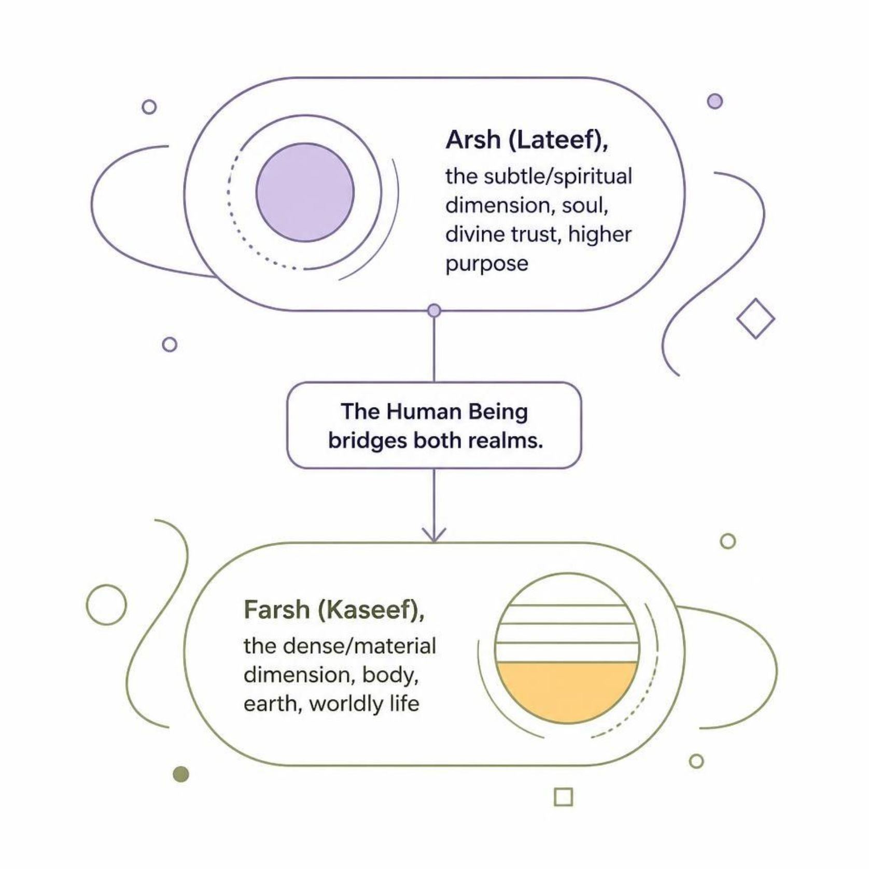
The Objective of Life
Arsh (Lateef) & Farsh (Kaseef) — The Two Dimensions of Existence
The lecture frames human existence across
two planes:
Arsh (Lateef) — the subtle, spiritual dimension. The soul carries the Divine trust; it is oriented toward the transcendent.
Farsh (Kaseef) — the dense, material dimension. The body inhabits the earth and acts within time and space.
The human being alone straddles both. Vicegerency is the mechanism by which the spiritual purpose is enacted in the material world — not as escape from it, but as responsible engagement within it.

Slide 6
The Inner Architecture — Three Types of Nafs
Understanding the Human Self
The Qur'an identifies the nafs (self/soul) as the seat of human moral life. The lecture presents three types, representing a spectrum of spiritual condition — not fixed categories, but states the self moves between.
Nafs al-Ammara
The commanding self — incites toward evil; dominated by desire
Nafs al-Lawwama
The self-reproaching self — feels guilt; oscillates between good and bad
Nafs al-Mutma'innah
The tranquil self — at rest in God; returns to the Lord well-pleased

Slide 7

Nafs al-Ammara — A Warning
When Desire Rules: The Dead Heart
Qualities of the Ammara State
"And yet, I am not trying to absolve myself: for, verily, man's inner self (NAFS-AMMARAH), does incite [him] to evil, and saved are only they upon whom my Sustainer bestows His grace. Behold, my Sustainer is much forgiving, a dispenser of grace!"
— Yusuf 12:53
Slave to desires; no limit to wanting
Ungrateful; disobedient to Allah
Religion is dismissed as irrelevant
The heart is dead — one cannot even want to obey
Slogans of Nafs al-Ammara heard today: "It's MY life!" · "Live as you wish!" · "You only live once!" · "I'm a self-made man/woman."
The danger: a dead heart does not feel its own deadness. It requires divine grace and self-awareness to escape this state.

Slide 8

Aqal, Qalb & Nafs al-Lawwama
The Role of Reason, Heart & Conscience
Nafs al-Lawwama — In Between
The self-reproaching self is the critical middle ground. It knows right from wrong and feels guilt when it falls short — that guilt is a sign of spiritual life.
Regret after wrongdoing
Oscillates between obedience and desire
The conscience is active — a foundation to build upon
Aqal (Reason)
Qalb (Heart)
Nafs (Action)
The lecture frames Aqal (reason) and Qalb (heart) as the two instruments whose combined orientation determines which state of nafs is manifest in action.

Slide 9

Nafs al-Mutma'innah — The Goal
The Tranquil Self: Returning Well-Pleased
"O reassured soul, return to your Lord, well-pleased and pleasing [to Him]."
— Al-Fajr 89:27–28
What Leads to Mutma'innah?
Deep Knowledge of Allah
Grounded understanding — not hopping between contradictory opinions
Strong Accountability Consciousness
A firm belief that every act will be answered for
As-Sidq (Truthfulness)
Truthful in personality and in dealings — first honest with oneself
Consistent Qur'anic Study
Focus and depth in understanding; admitting faults rather than self-justification

Slide 10
Contemporary Application & Student Engagement
Vicegerency in Professional Life: Attribute-to-Action Mapping
How do Divine Attributes shape personal and professional conduct? The following examples are classroom applications for discussion — connecting theology to lived responsibility.
Al-Khaliq (The Creator)
Al-Razzaq (The Sustainer)
Professional link: Engineers and designers hold creative power. Ethical design — choosing not to harm — mirrors the Creator's purposeful act.
Professional link: Stewardship of natural resources, sustainable technology choices, and not exploiting what sustains others.
Al-Adl (The Just)
Al-Hakim (The Wise)
Professional link: Fairness in data, AI systems, and institutional decisions — justice is not optional for the vicegerent.
Professional link: Wisdom-driven leadership: considering consequences, not just efficiency; asking should we, not only can we.
Reflective Questions for Discussion
Which type of nafs best describes a person who ignores environmental destruction for profit — and why?
Can a professional be a genuine vicegerent without conscious knowledge of Allah's attributes? Discuss.
Identify one Divine Attribute and map it to a specific decision you will face in your career.

